Slide 1
HR Data analysis Project
Team members:
Ali Gamal Fouad - 21084726
Hagar Ehsan Abdelhamid – 21080140
Marawan Ahmed Mohamed Mortada - 21059633
Nada Khaled Abdeljawad - 21084347
Osama Sayed Hussien - 21093496

Slide 2

Agenda
Project Concept
Phase 1: Data Cleaning & Preprocessing
Phase 2: Analysis (Dax & Relationships)
Phase 3: Visualization
Phase 4: Commentary

Slide 3

HR Project Concept
The project helps organizations make better people decisions through using advanced metrics, turning employee data into useful insights.
It tracks keys areas like performance, engagement, turnover, training and satisfaction.
Our purpose: for companies to use this predictive analysis to anticipate needs, reduce hiring costs, and boost retention.

Slide 4
Project’s Timeline
Cleaning
Phase 1:
Making sure the data is accurate, consistent and free of errors.
Analysis
Phase 2:
Digging into the data and figuring out ways to find patterns, trends, and useful insights.
Visualization & Commentary
Phase 3:
Turning Data into a dashboard as a visual containing a series of reports so that it’s easy to understand.

Slide 5
Data cleaning & Pre-processing

Slide 6
Chart
Ss of powerquery

Slide 7
Explanation of steps
Format date
Using unpivot method to reflect correct performance ID with job/environment/relationship satisfaction.
Adjust binary and prefer not to say genders to male and female for easier view of the data.
Leaving duplicates for accurate steps.

Slide 8
Analysis (dax & relationships)

Slide 9
Title
Subtitle
Subtitle
Subtitle
Add text, images, art, and videos.
Add transitions, animations, and motion.
Save to OneDrive, to get to your presentations from your computer, tablet, or phone.
Open the Design Ideas pane for instant slide makeovers.
When we have design ideas, we’ll show them to you right there.
This PowerPoint theme uses its own unique set of colours, fonts, and effects to create the overall look and feel of these slides.
PowerPoint has tons of themes to give your presentation just the right personality.

Slide 10
Visualization & commentary

Slide 11
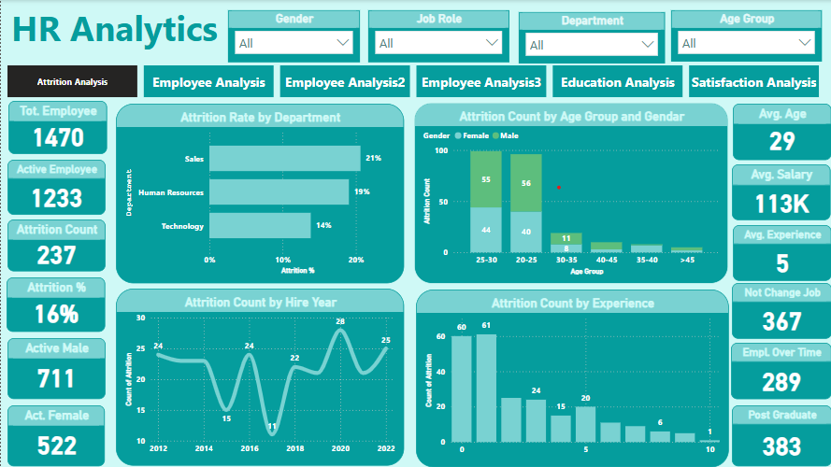
Attrition Analysis
As illustrated in this report the attrition percentage is 16% for the past 10 years.
The highest turnover for the employees takes place in the Sales department with a 21%.
The employees most likely to resign are those with less than 2 years of experience.

Slide 12
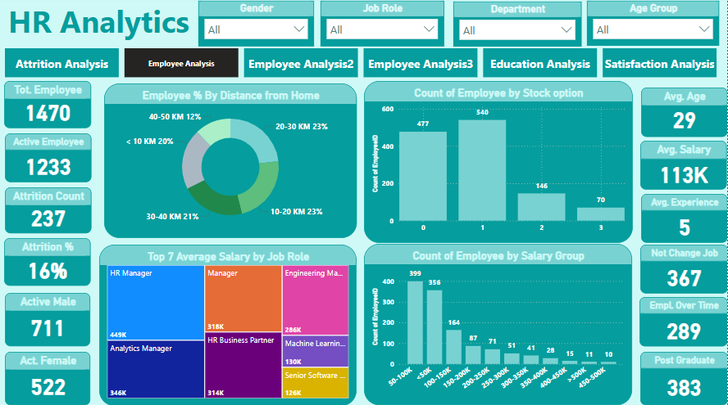
Employee Analysis
Active employees are 1233 employee with average salary of 113K and average age of 29.
66% of the employees are less than 30 KM away from the workplace.
540 Employees have decided to take their bonus as a Stock option.

Slide 13
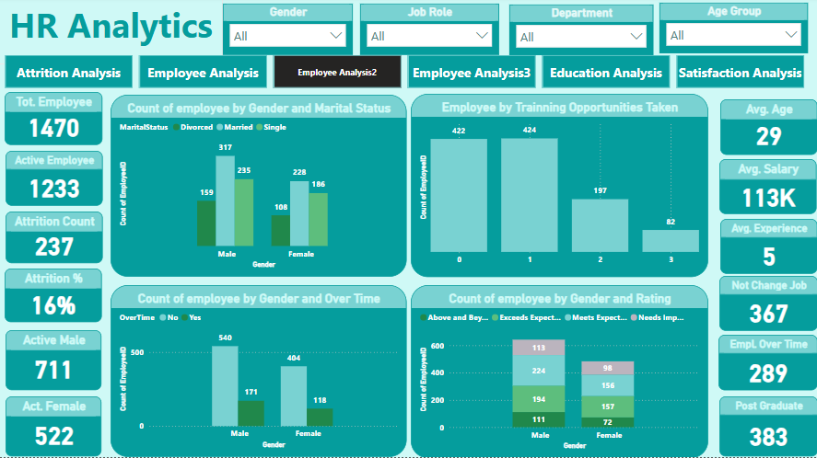
Employee Analysis
545 of the employees are married , 317 of them are males and 228 are females.
Only 289 of the employees where subject to overtime , 171 of them were males and 118 were females.
380 of the employees took a rating of “Meets Expectations”.

Slide 14
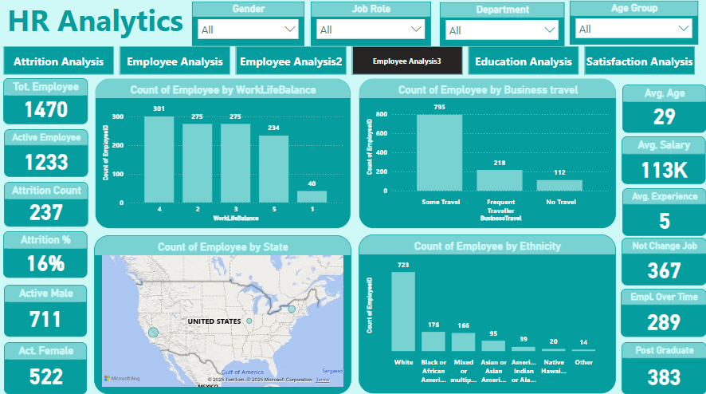
Employee Analysis
1013 of the employees travelled to complete business tasks.
723 of the employees are “White” people and they are the largest ethnic group.
Most of the employees lives in California and New York.

Slide 15
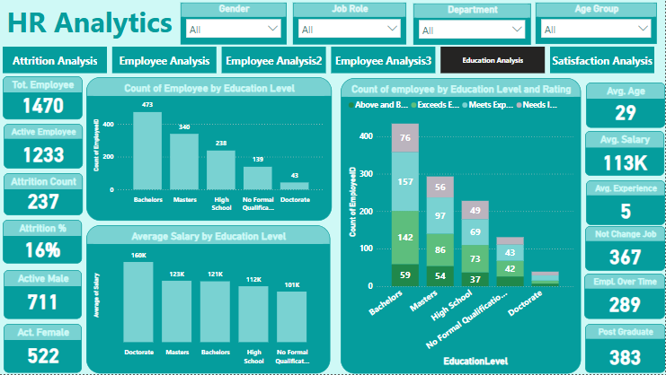
Education Analysis
473 of the employees holds a Bachelors Degree.
The PhD holders are the highest paid employees.
383 of the employees took a post graduate degree.

Slide 16
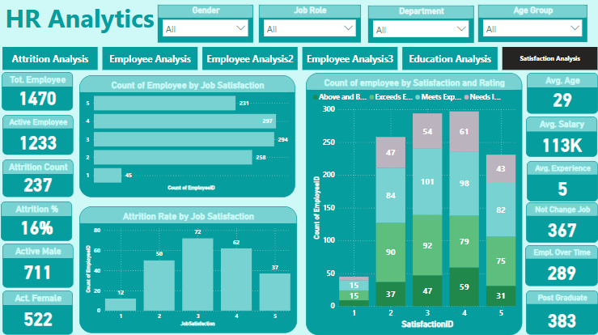
Satisfaction Analysis
231 of the employees are highly satisfied of their job , and 45 of the employees aren’t satisfied at all.
Most of the resigned employees were fairly satisfied.

Slide 17



Summary
With PowerPoint, you can create presentations and share your work with others, wherever they are. Type the text you want here to get started. You can also add images, art, and videos on this template. Save to OneDrive and access your presentations from your computer, tablet, or phone.

Slide 18




Thank you

